Slide 1

SOLAR POWER PLANT DESIGN
Introduction

Slide 2
Why Solar?
India Sets Year-on-year Targets to Reach Ambitious 2022 Solar Goal
Actual Installed capacity
Targeted installed solar capacity
Notes: FY = All years in chart are fiscal year from April 1 to march 31; 1 GW = 1,000 MW
Sources: Bioomberg new energy finance (BNEF); The economic Times

Slide 3
Contribution to total capacity demand
installed grid power capacity from all sources in india as of 31 march 2020

Slide 4
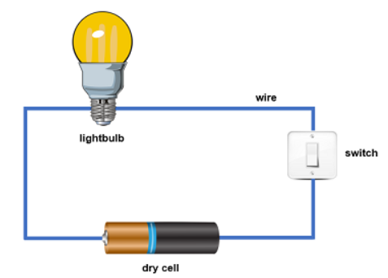
Quick recap of the Basic Electricity

Slide 5
Electricity....what is that?

Slide 6
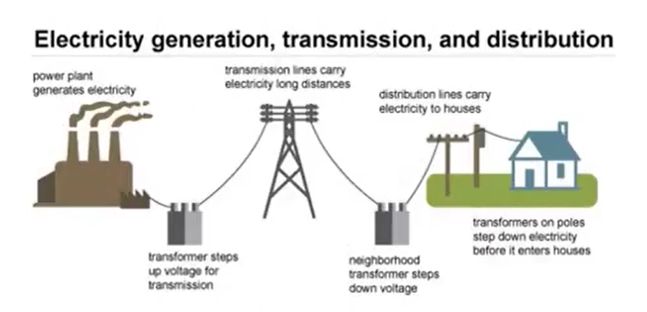
The Three broad classification of Power Sector
GENCO TRANSCO DISCOM

Slide 7
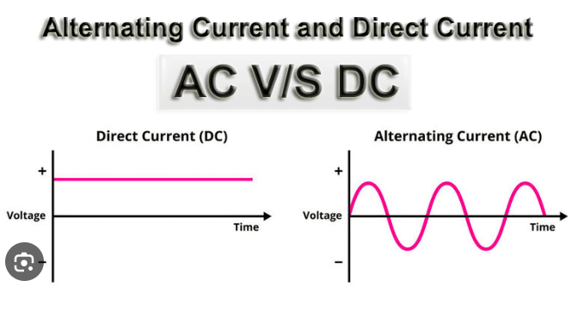
AC&DC
DC flows in one direction
AC changes its direction periodically
Advantage of AC over DC
What solar plant produce AC or DC??
-

Slide 8
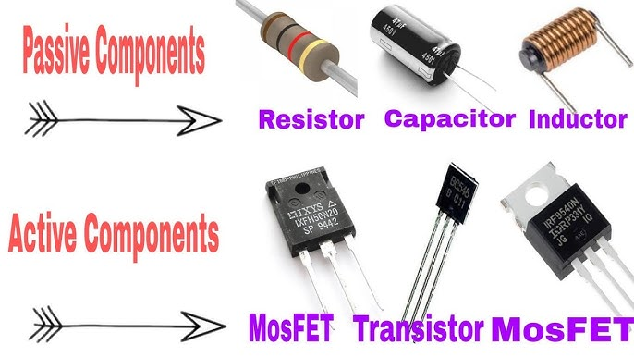
PASSIVE ELECTRICAL COMPONENTS
1. Resistor
2. Inductor
3. Capacitor

Slide 9
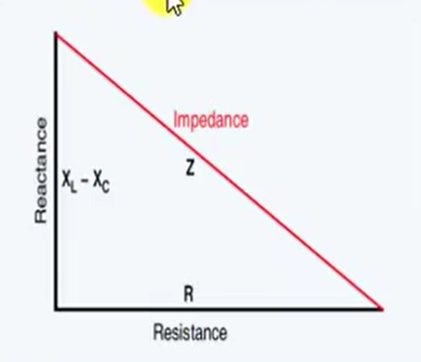
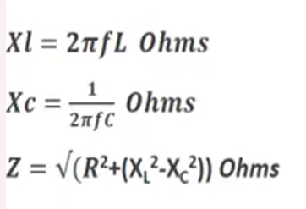
1. Inductor opposes rate of change of current & capacitor opposes rate of change of voltage.
2. The resistance offered by Inductor & capacitor is called inductive (K & reactance.
3. Impedence (Z) is the combined effect of R, Xl & Xc

Slide 10
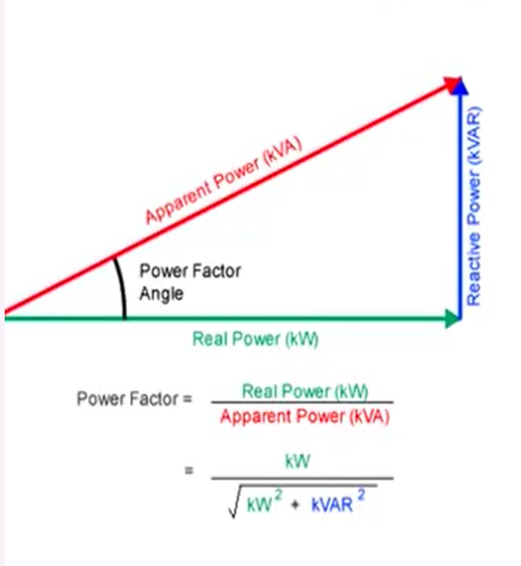

Power Factor?
It is also the ratio of resistance to impedance
What is the ideal power factor?
What is the typical power factor of solar Power plant?

Slide 11
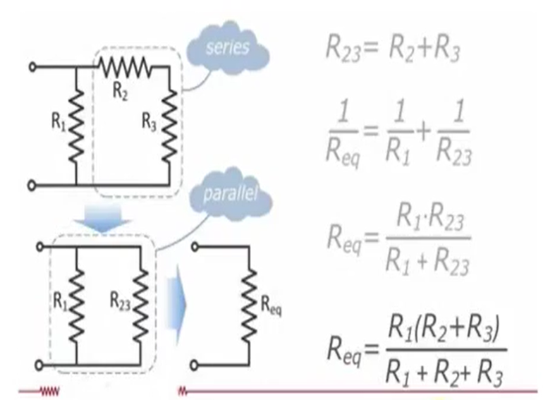


Series & Parallel circuit
Resistance is added up in
series circuit
Resistance is reduced in
parallel circuit

Slide 12


Slide 13
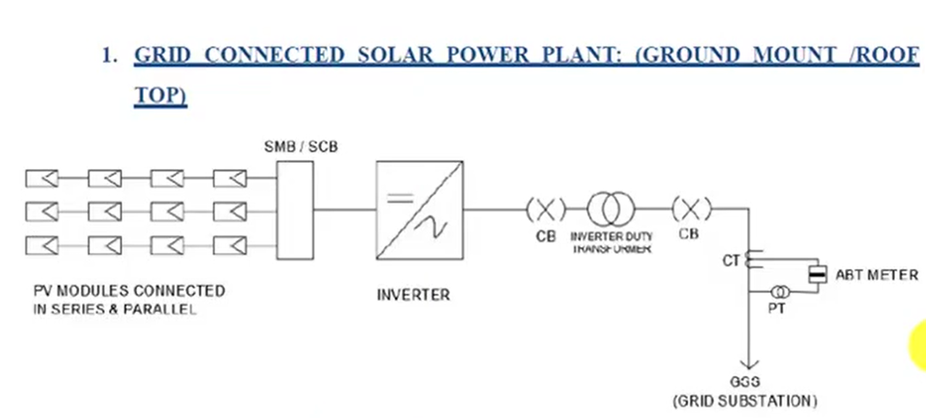
Typical SLD of Solar Power Plant

Slide 14

Solar Modules

Slide 15
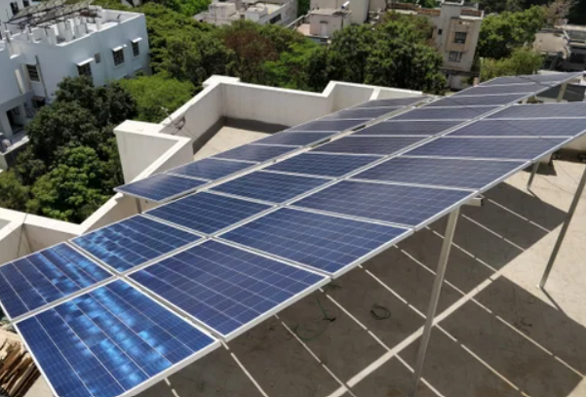
Solar Modules

Slide 16
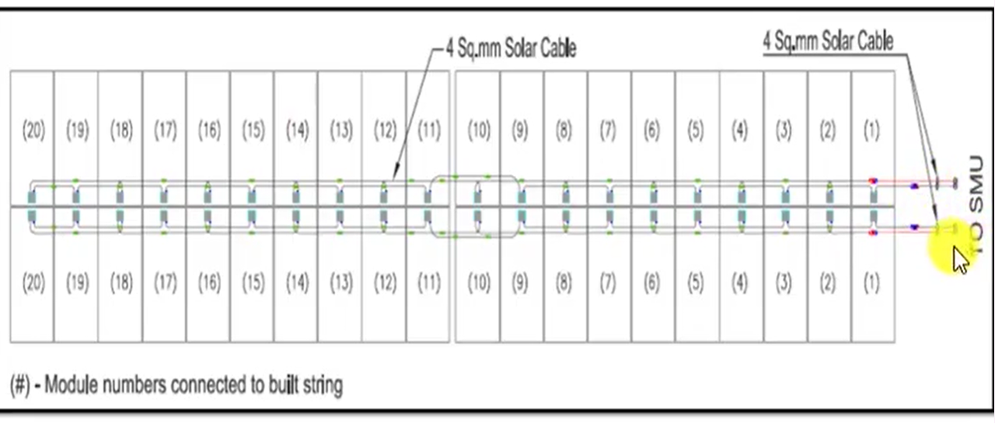
Series Connection

Slide 17
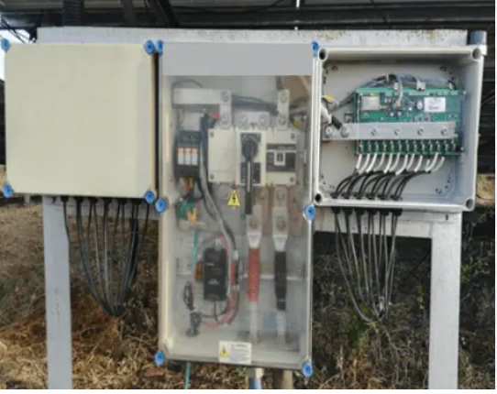
String Monitoring Box (SMB)

Slide 18
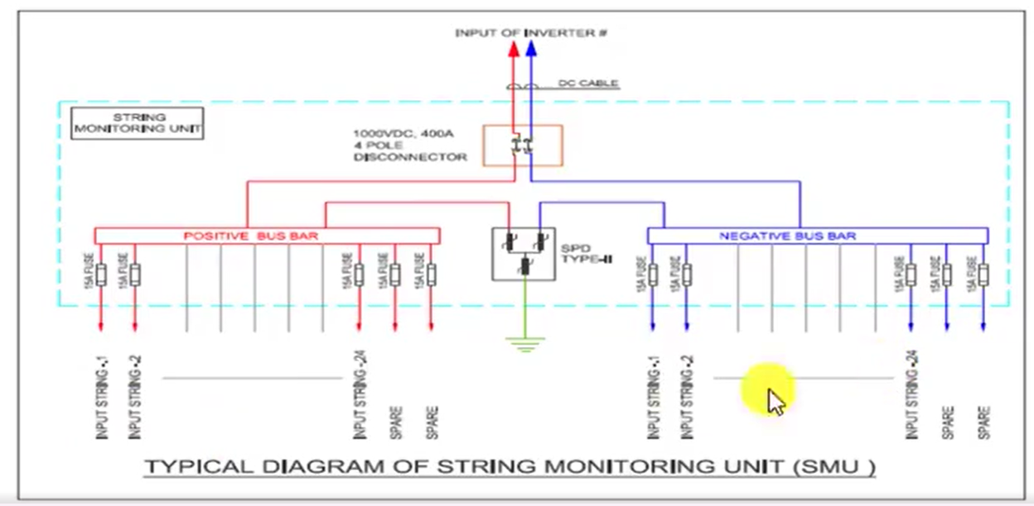
SCB Circuit

Slide 19
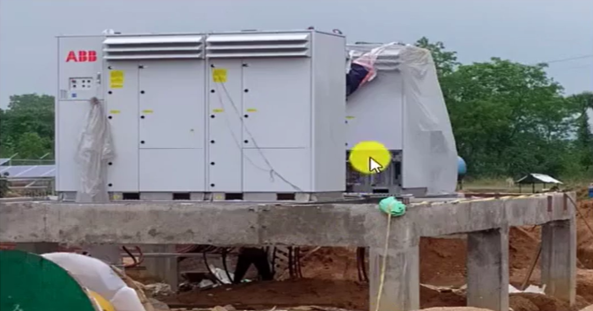
Solar Inverter

Slide 20
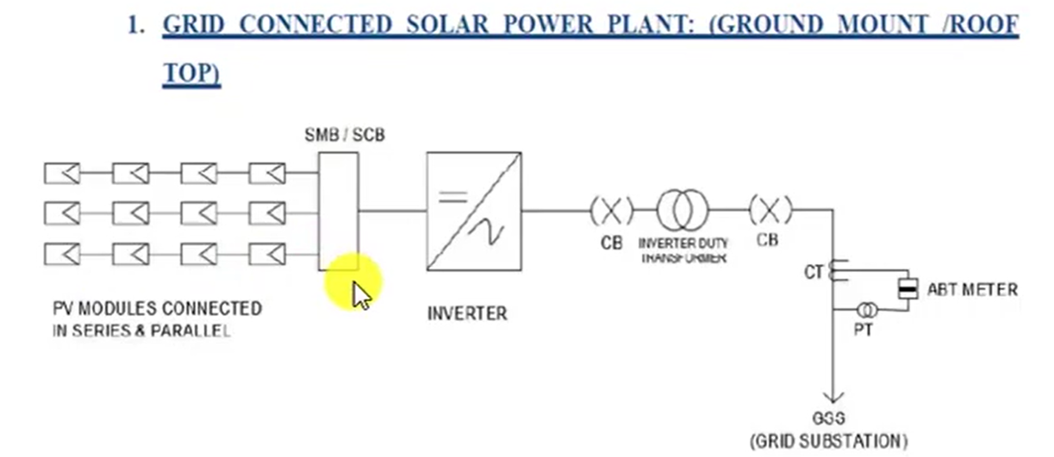
Inverter duty transformer

Slide 21
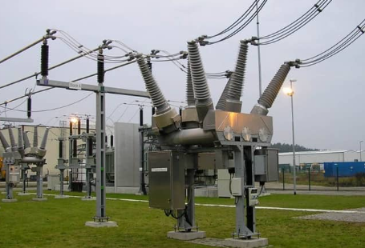
Circuit breaker

Slide 22
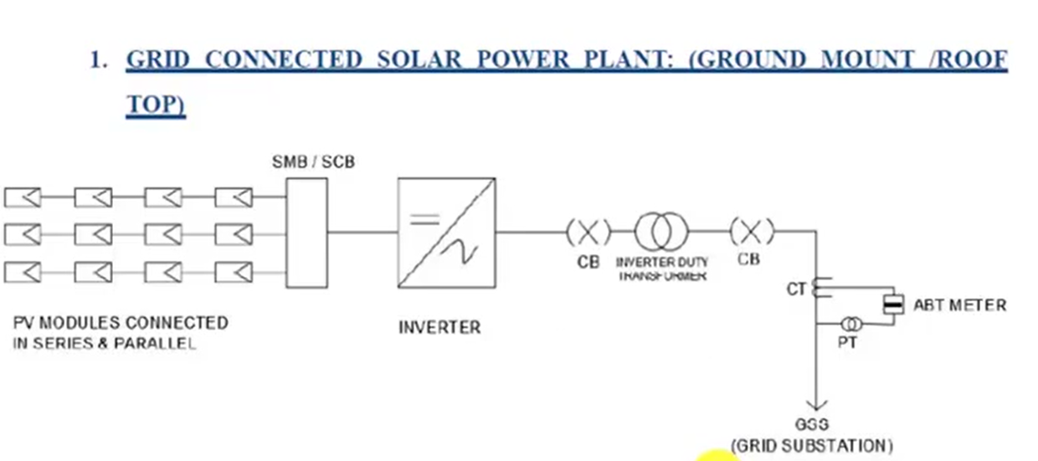
Typical SLD of solar power plant

Slide 23
Thank you

